Slide 1
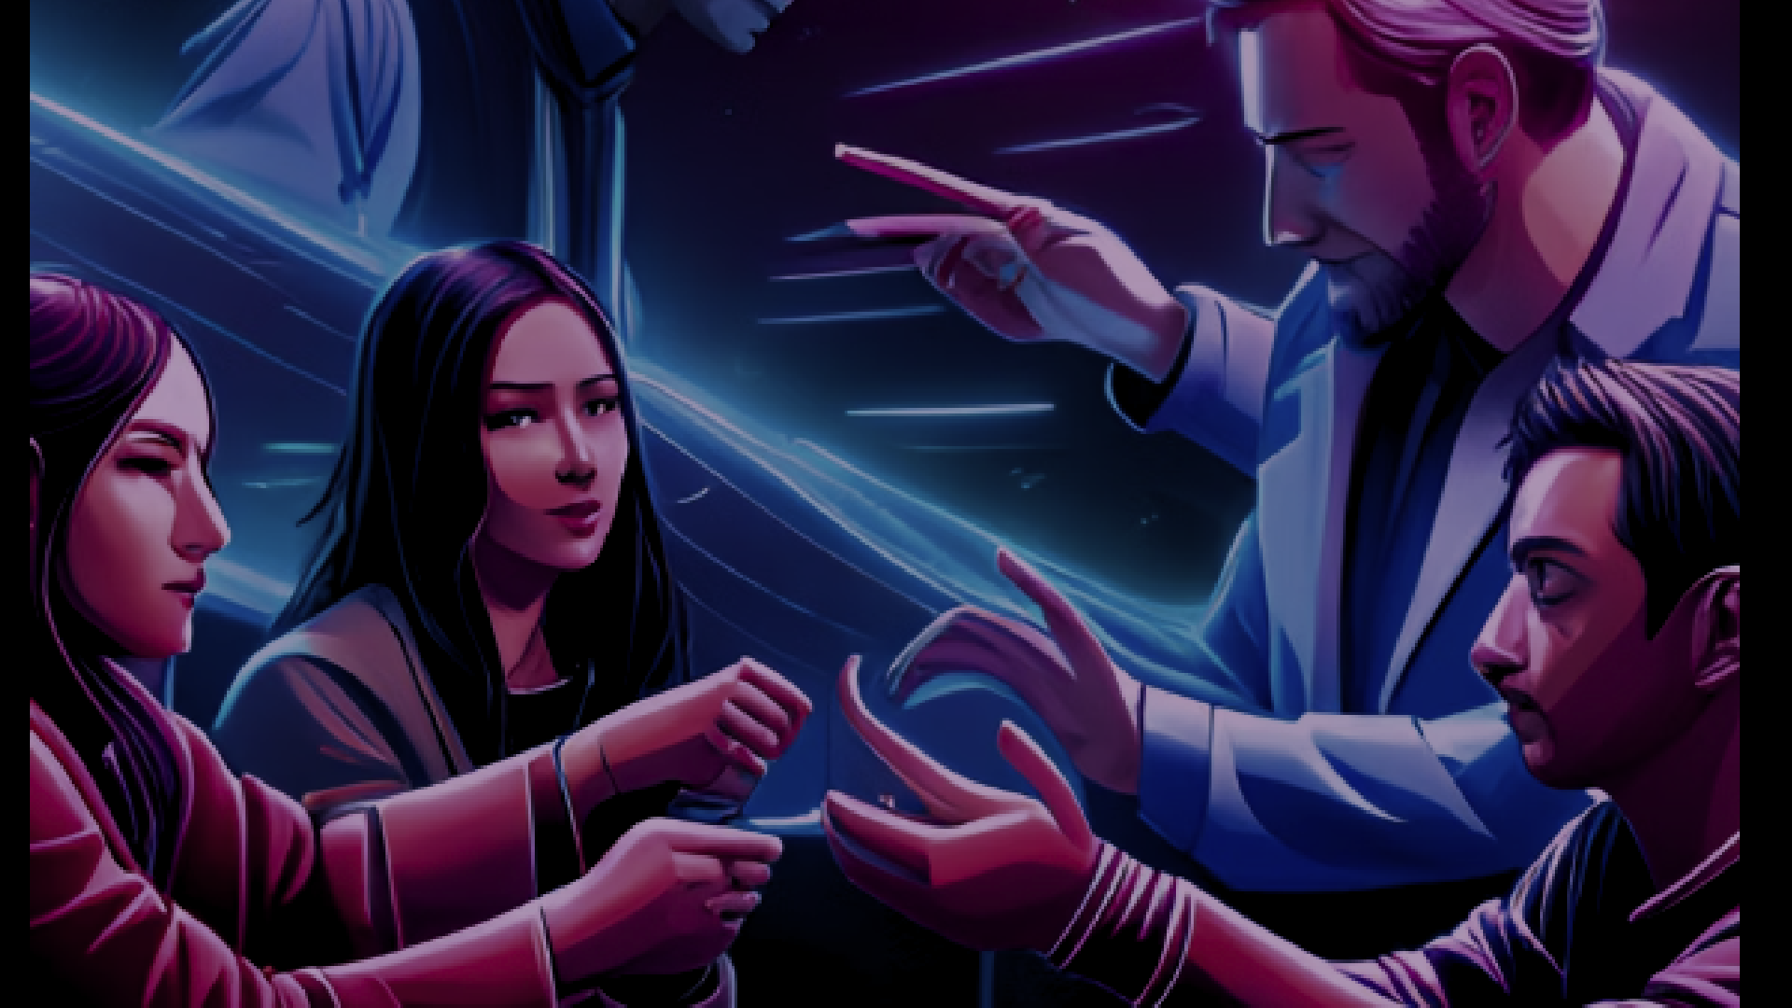
MOVie Recommendation
System
https://aranavmahalpure-movie-recommendation-system--app-bofu8x.streamlit.app/

Slide 2
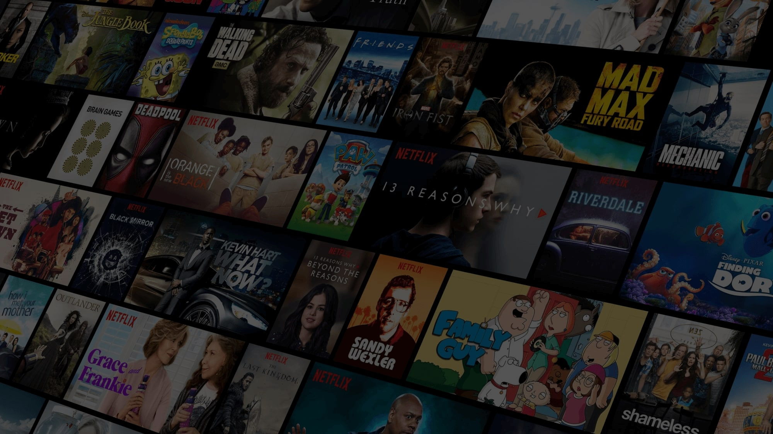



Movie Recommendation System
It Recommends you a list of movies From your Given Movie

Slide 3

OUTLINE
Overview
Problem Statement Objectives Methodology
System Requirements
Design
Software Checking
Project Implementation Conclusion

Slide 4

Overview

Slide 5
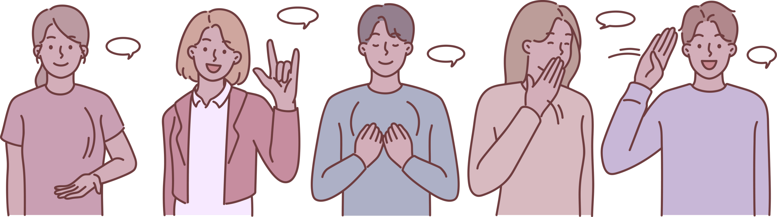
OVERVIEW
The recommendation system analyzes the input of the user taken, and then it uses this information to try to find similar movies. This information is available in the database (e.g., lead actors, director, genre, etc.). After that, the system provides movie recommendations for the user.

Slide 6


Slide 7

Problem Defination and Objectives

Slide 8


PROBLEM DEFINITION
The goal of the project is to recommend a movie to the user.
Providing related content out of relevant and irrelevant collection of items to users of
online service providers.

Slide 9
OBJECTIVES
Improving the Accuracy of the recommendation system Improve the Quality of the movie Recommendation system Improving the Scalability.
Enhancing the user experience.

Slide 10

Methodology

Slide 11

METHODOLOGIES OF PROBLEM STATEMENT
The proposed approach is for improving the scalability and quality of the movie recommendation system . unifying Content-Based Filtering and Collaborative Filtering, so that the approaches can be profited from each other. For computing similarity between the different movies in the given dataset efficiently and in
least time and to reduce computation time of the movie recommender engine I used cosine similarity measure.

Slide 12

Software Requirements

Slide 13
SOFTWARE REQUIREMENTS
Hardware Requirements
A PC with Windows/Linux OS
Processor with 1.7-2.4gHz speed
Minimum of 8gb RAM
Software Specification
Jupyter Notebook
Streamlit package
PyCharm Editor
Python libraries

Slide 14

System Design

Slide 15
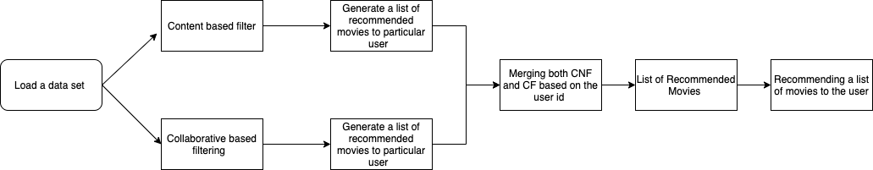
Data flow Diagram

Slide 16
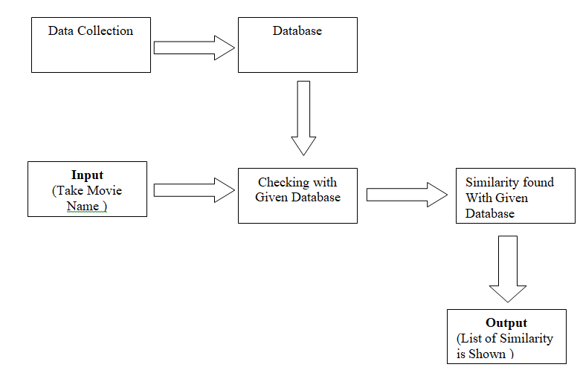
System Architecture

Slide 17
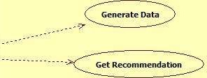
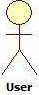
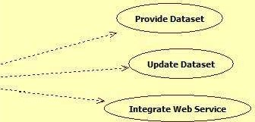
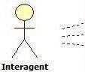
Use Case Diagram

Slide 18
TOOLS AND TECHNOLOGIES USED
Jupyter Notebook
Python Libraries
Pycharm
Git/Github
Streamlit
Streamlit Cloud for Hosting

Slide 19
Implementation
It gives the results of similar movies related to my applied set of movies.
It is confined of providing the results with the help of cosine similarity formula and count vectorizer.
It provides the output of movies with the help of datasets governed through csv files.
Not confined to provide advance hybrid string matching elements solutions and responses.
To find out the related content of the user in a given set of collection and to his interest feed.
Providing the accurate and most confined results by using the distance between two vectors model and graph plotting examples.
Using the cosine similarity formula for finding the similarity scores/matching of the two texts more accurately.
By providing accurate results by the usage of movies datasets by TMDB in the existing project work.

Slide 20
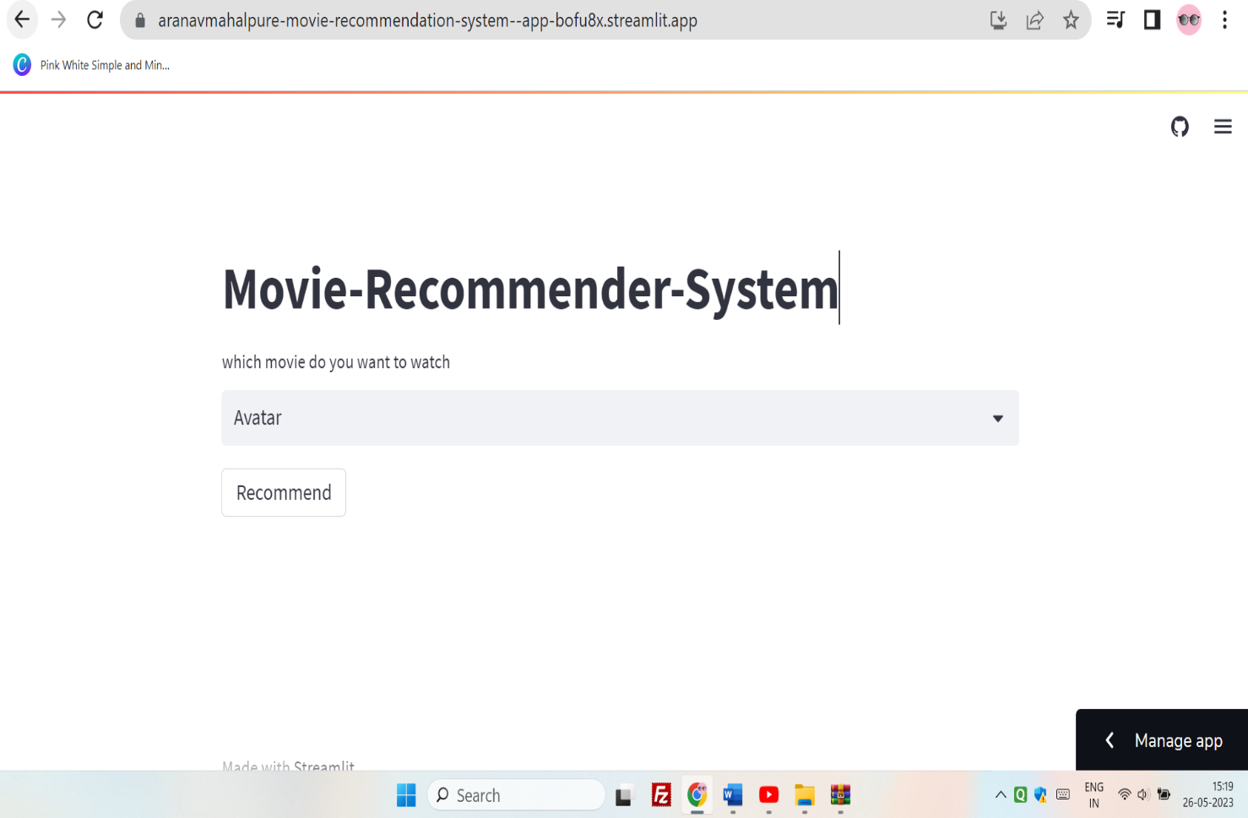
Software Checking

Slide 21
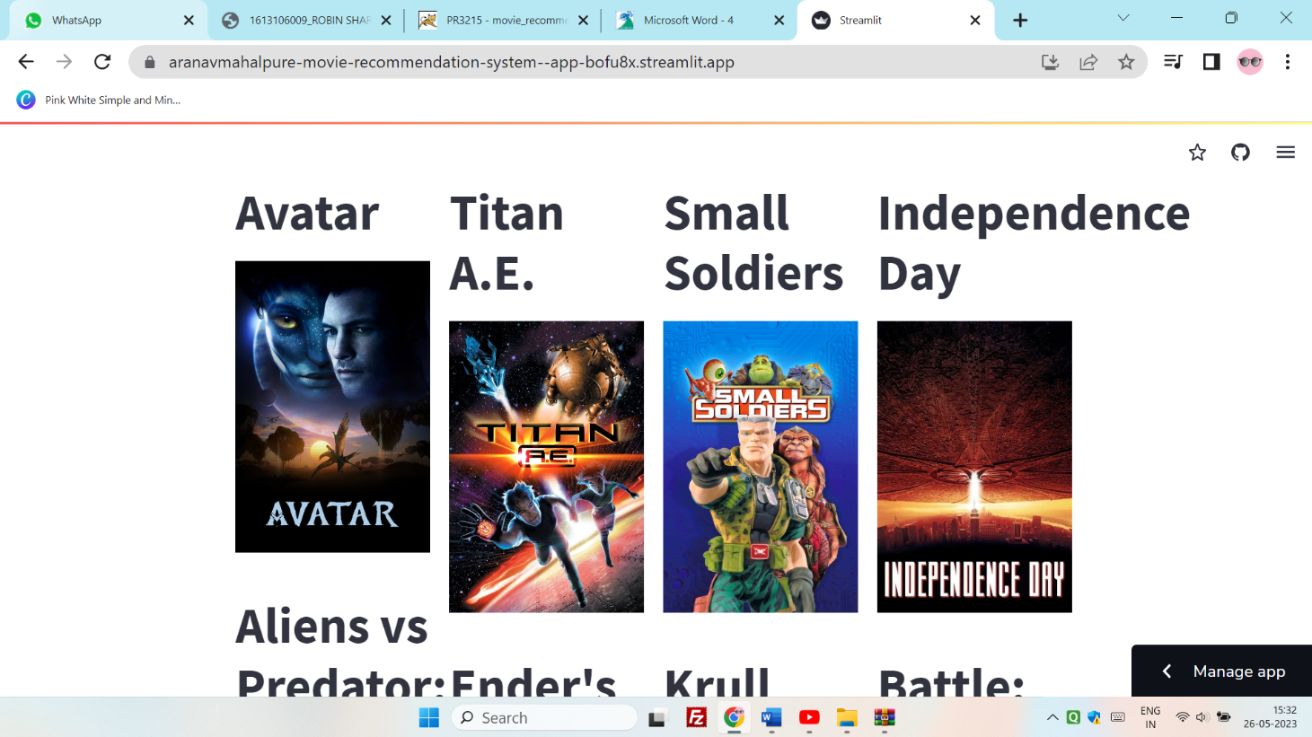
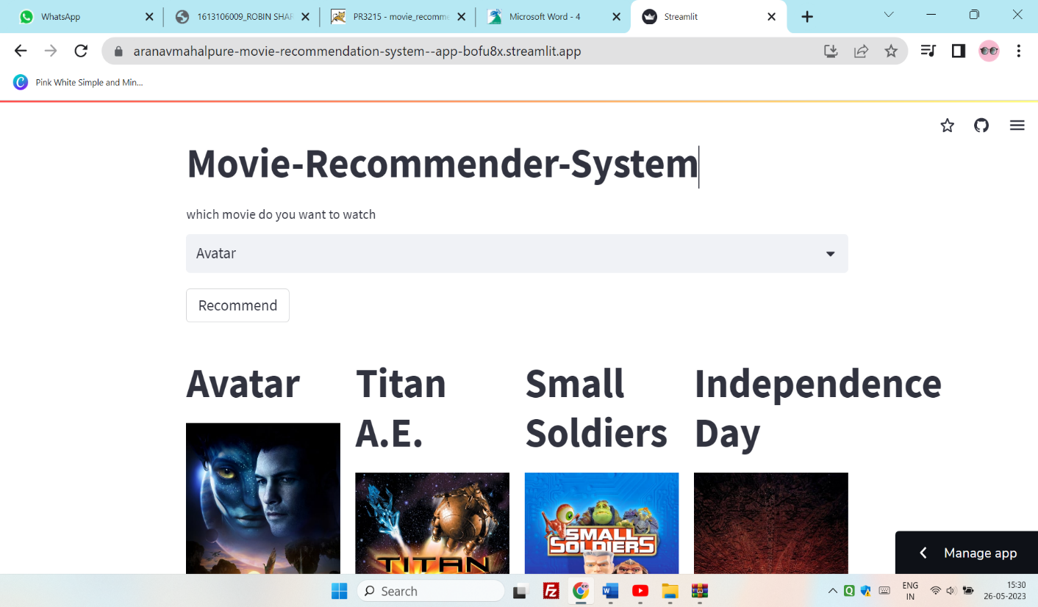
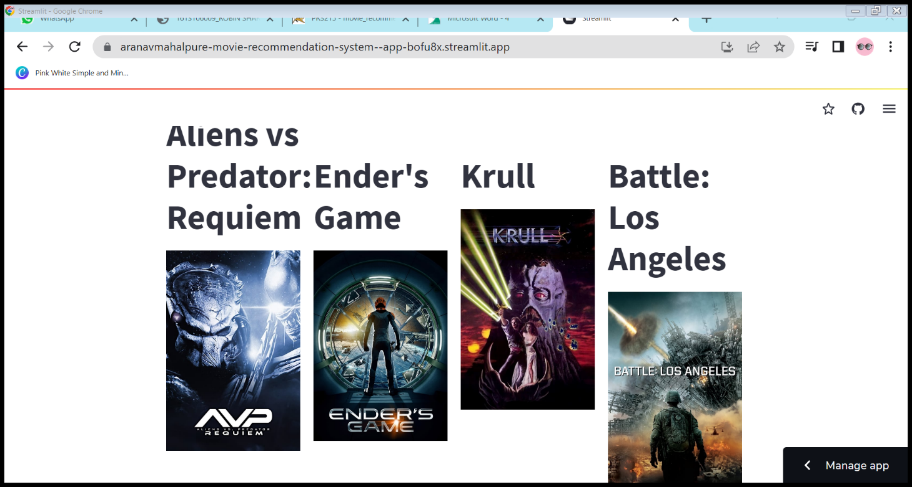
Results

Slide 22


CONCLUSION
In this project we have implemented and learn the following things such as Building a Movie Recommendation System
To find the Similarity Scores and Indexes.
Compute Distance Between Two Vectors
Cosine Similarity.

Slide 23


T
H
A
N
K
Y
O
U

